Slide 1
Tracing the link between Education and Development:
Global Inequalities through the Lens of PISA Scores (2022)
Understanding the intricacies of the relationship between education and the dynamics of development, has triggered a great deal of academic inquiry and policy discussions. In this paper, we are going to exploit the PISA scores obtained until the year 2022.
Prantika Mukherjee
Ritobhash Daw
Ivan Das
Annwesha Pal
Department of Economics, Presidency University (3rd Year)

Slide 2

Research Objectives:
Analyze whether and how the PISA scores capture the impact on education of various demand and supply-side factors
Establish the impact of education on the nature of development across regions
Observe how inequalities in educational outcomes vary across and within countries
The research methodology involves applying regression techniques, while ensuring the accuracy of the specified models through diagnostic corrections, and using scatter plots to visually assess the relationships between variables. Confidence intervals are also used to quantify and understand deviations in the distribution of a curated inequality indicator for PISA scores.

Slide 3
Literature Review
It is reasonably believed by researchers that the PISA project is grounded in Human Capital Theory, which views education as a crucial investment in economic growth. High PISA scores in science and mathematics are often seen as indicators of national competitiveness. (Sjøberg & Jenkins, 2022)
Past research in this area has examined how non-educational factors, such as socio-economic status, cultural values and social capital, significantly influence PISA outcomes, challenging the conventional assumption that school quality alone determines performance. Two distinct paths to high PISA rankings have also been highlighted: individualistic and egalitarian cultures (eg. Finland, Canada) and collectivist, hierarchical societies (eg. South Korea, Singapore). (Meyer & Schiller, 2013)
An exploration of the relationship between PISA scores, economic growth and employment across various sectors, has earlier found that higher scores in mathematics, science and reading are linked to increased economic productivity and workforce distribution. This study aligns with endogenous growth theories, suggesting that investment in education fosters innovation and technological advancement. (Cheung & Chan, 2003)
Another wing of research has analysed PISA data using network theory, identifying clusters of countries with similar student performance and socio-economic backgrounds. The findings state that in some countries less privileged students perform well, while in others private schools with more privileged students achieve higher results, highlighting issues of educational inequality. (Neuman, 2022)

Slide 4

Why PISA?
~Programme for International Student Assessment
Created by the Organisation for Economic Co-operation and Development (OECD), PISA tests the skills and knowledge of 15-year-old students in mathematics, reading and science. Eighty-one countries and economies took part in the 2022 assessment.
Why 15-year olds? - It is when young people in most OECD countries are nearing the end of compulsory education.
Key Features:
Does not prescribe or promote any one curriculum
Assesses skills such as collaborative problem solving, global competence and creative thinking ("learning in a digital world“, "critical media literacy“, “financial literacy”)

Slide 5
What makes PISA unique?
Only international education survey to measure the knowledge and skills of 15-year-olds - Surveys are usually carried out every three years, allowing participating countries and economies to track their progress in meeting key learning goals
Public policy issues - "Are our schools adequately preparing young people for the challenges of adult life?", "Are some kinds of teaching and schools more effective than others?“, "Can schools contribute to improving the futures of students from immigrant or disadvantaged backgrounds?“
Lifelong learning - In addition to measuring student performance in reading, mathematics and science literacy, PISA also asks students about their motivations, beliefs about themselves and learning strategies
Literacy - Rather than examining mastery of specific school curricula, PISA looks at students’ ability to apply knowledge and skills in key subject areas

Slide 6
Hypothesis
Scores correlate positively to per capita income and this relation is consistent across regions
Scores depend inversely on pupil-teacher ratio, while directly on government expenditure on education and access to facilities like internet
Gender equality and higher standards of living are reflected positively in scores, while societal inequality is reflect negatively
High PISA scores correlate with increasing dominance of the service sector at the cost of other sectors
Literature Gap
The existing literature on the study of PISA scores has not adequately explored within-country variations in scores over time. Understanding how well countries ensure a consistent quality of education for all students is a critical area of research.

Slide 7
Description of Variables

Slide 8
Summary Statistics

Slide 9
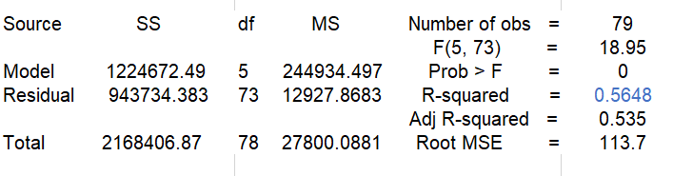
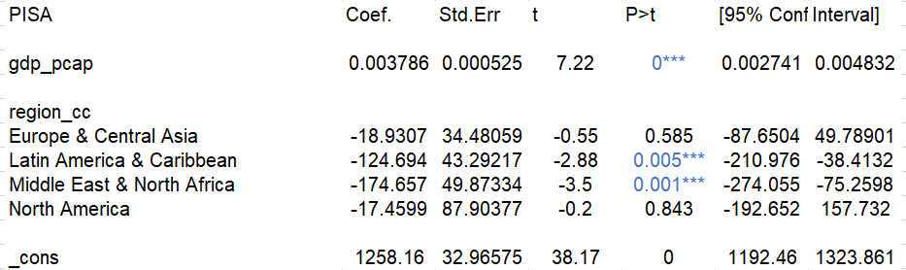
Relationship b/w PISA scores and GDP per capita (region-wise analysis)
The regression model shows that GDP per capita is highly significant and has a strong positive impact on PISA scores
The model uses East Asia & Pacific as the reference category, so all regional coefficients represent how PISA scores differ from this region, controlling for GDP per capita
Significant Gaps: Latin America & Caribbean and Middle East & North Africa have significantly lower PISA scores compared to East Asia & Pacific, even after adjusting for GDP
Non-Significant Differences: Europe & Central Asia and North America have no significant difference in PISA scores when compared to East Asia & Pacific, implying that their education results are not significantly different if one controls for GDP

Slide 10
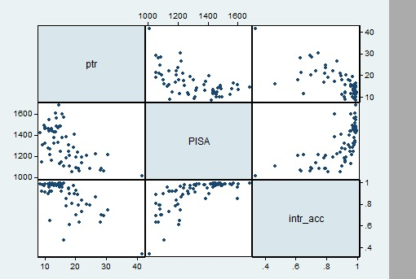
Scatterplot matrix of the ‘supply-side’ variables affecting PISA scores
PISA vs. Pupil-Teacher Ratio:
As the pupil-teacher ratio increases, PISA scores seem to decline. Smaller student groups may mean better individual attention and hence, better learning outcomes
PISA vs. Internet Accessibility:
More internet accessibility is associated with higher PISA scores. A positive relationship can be seen in the data points as internet accessibility increases
Improved access to digital resources may boost learning opportunities, enhance access to information and support new teaching approaches
Pupil-Teacher Ratio vs. Internet Accessibility:
The scatterplot exhibits a non-linear pattern- countries with high internet access are not necessarily those with uniformly low or high pupil-teacher ratios

Slide 11
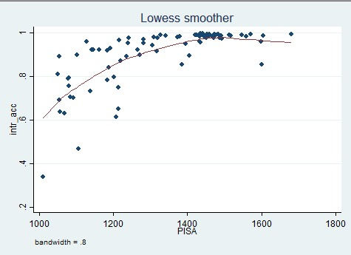
Scatterplot showing the relation between Internet Access and PISA scores
This scatterplot shows the relationship between PISA scores (x-axis) and Internet Accessibility (y-axis), with a Lowess (Locally Weighted Scatterplot Smoothing) curve applied to capture the trend in the data: As internet access increases, PISA scores tend to rise initially
However, beyond a certain level of internet access (around 0.8–1), PISA scores plateau, indicating diminishing returns, where increasing internet access further does not significantly boost academic performance
Increased access to the internet can positively impact PISA scores to a certain point, but excessive or poorly directed internet use can lead to lower scores; essentially, there appears to be a ‘sweet spot’ for optimal internet usage in relation to academic achievement as measured by PISA tests

Slide 12
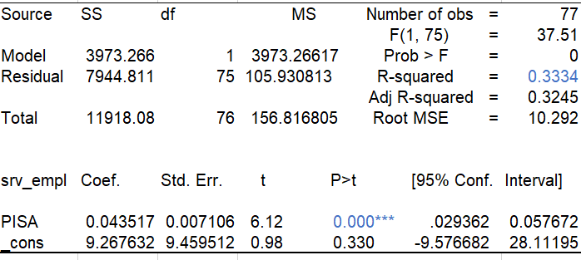
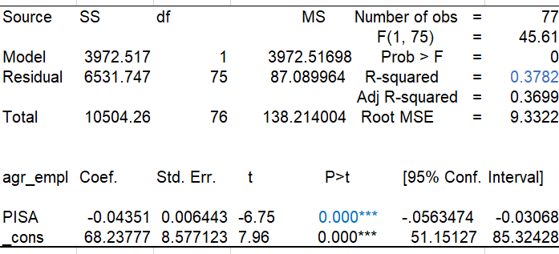
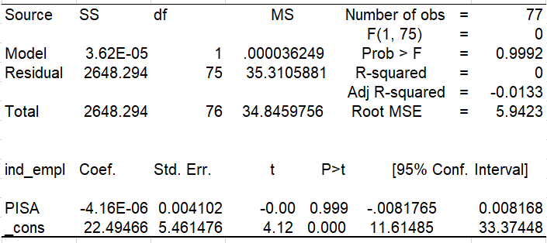
Impact of education on the nature of economic development
We analysed the impact of PISA scores on sectoral employment and found: an increase in PISA scores is associated with a rise in employment in the service sector and a decline in employment in the agricultural sector, while impact on employment in the industrial sector remains inconclusive

Slide 13
PISA includes assessment of students’ employability skills alongside vocational education and training
Intangible services like health, education and finance, require specialized skills and knowledge- thus, the positive statistically-significant relationship
Although education should increase agricultural productivity as well (ensuring higher returns from agriculture), we find the % employed in this sector declining with improved educational performance- may be due to wage differences across sectors (educated individuals do not find farm work equally remunerative)
Impact on industrial employment is inconclusive- while some industries may be labour-intensive (not requiring very high educational qualification), others may be knowledge-based and capital-intensive that require educated individuals (eg. semi-conductor & chip-making industries requiring substantial R & D)
With increasing number of high-skilled workers, middle and low-skilled workers are being pushed down the job ladder to occupy the less-attractive and less well-paid jobs

Slide 14
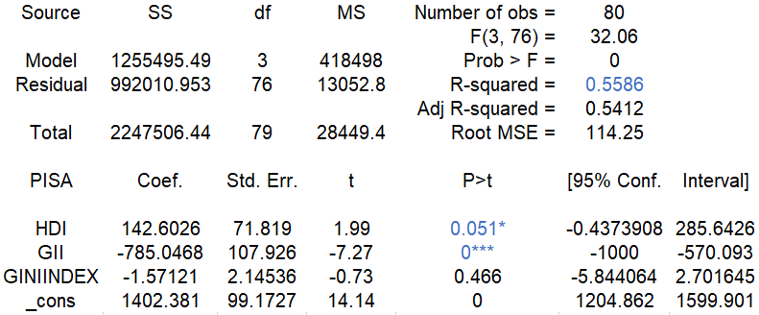
EXAMINING THE INFLUENCE OF HDI,GII AND GINI ON PISA PERFORMANCE
There is no clear relationship between the Programme for International Student Assessment (PISA) and the Gini index- students from lower socio-economic backgrounds are pushed out of education all together, their performance not reflected.
The Programme for International Student Assessment (PISA) shows a strong correlation with gender inequality, where countries with greater gender equality tend to have higher overall PISA scores, indicating that a more equitable society between genders often leads to better educational outcomes for both boys and girls across various subjects.

Slide 15
The relationship between PISA scores and the Human Development Index (HDI) is generally considered positive, meaning that countries with higher HDI values tend to also have higher PISA scores, indicating a correlation between a country's overall development level and the academic performance of its students as measured by PISA tests; essentially, higher levels of human development are associated with better educational outcomes as shown by PISA results.
Despite not focussing on gender gaps in education, the evidence that improving outcomes for women and girls also improves outcomes for boys and men indicates that this is not a zero-sum effort.
Future research should explore the impact of improved societal gender equality on gender gaps in education, however, the evidence from this study—that everyone benefits—is encouraging.
Policies and initiatives that target societal levels of gender equality, therefore, have the potential to impact positively on diverse social outcomes to everyone’s benefit.

Slide 16
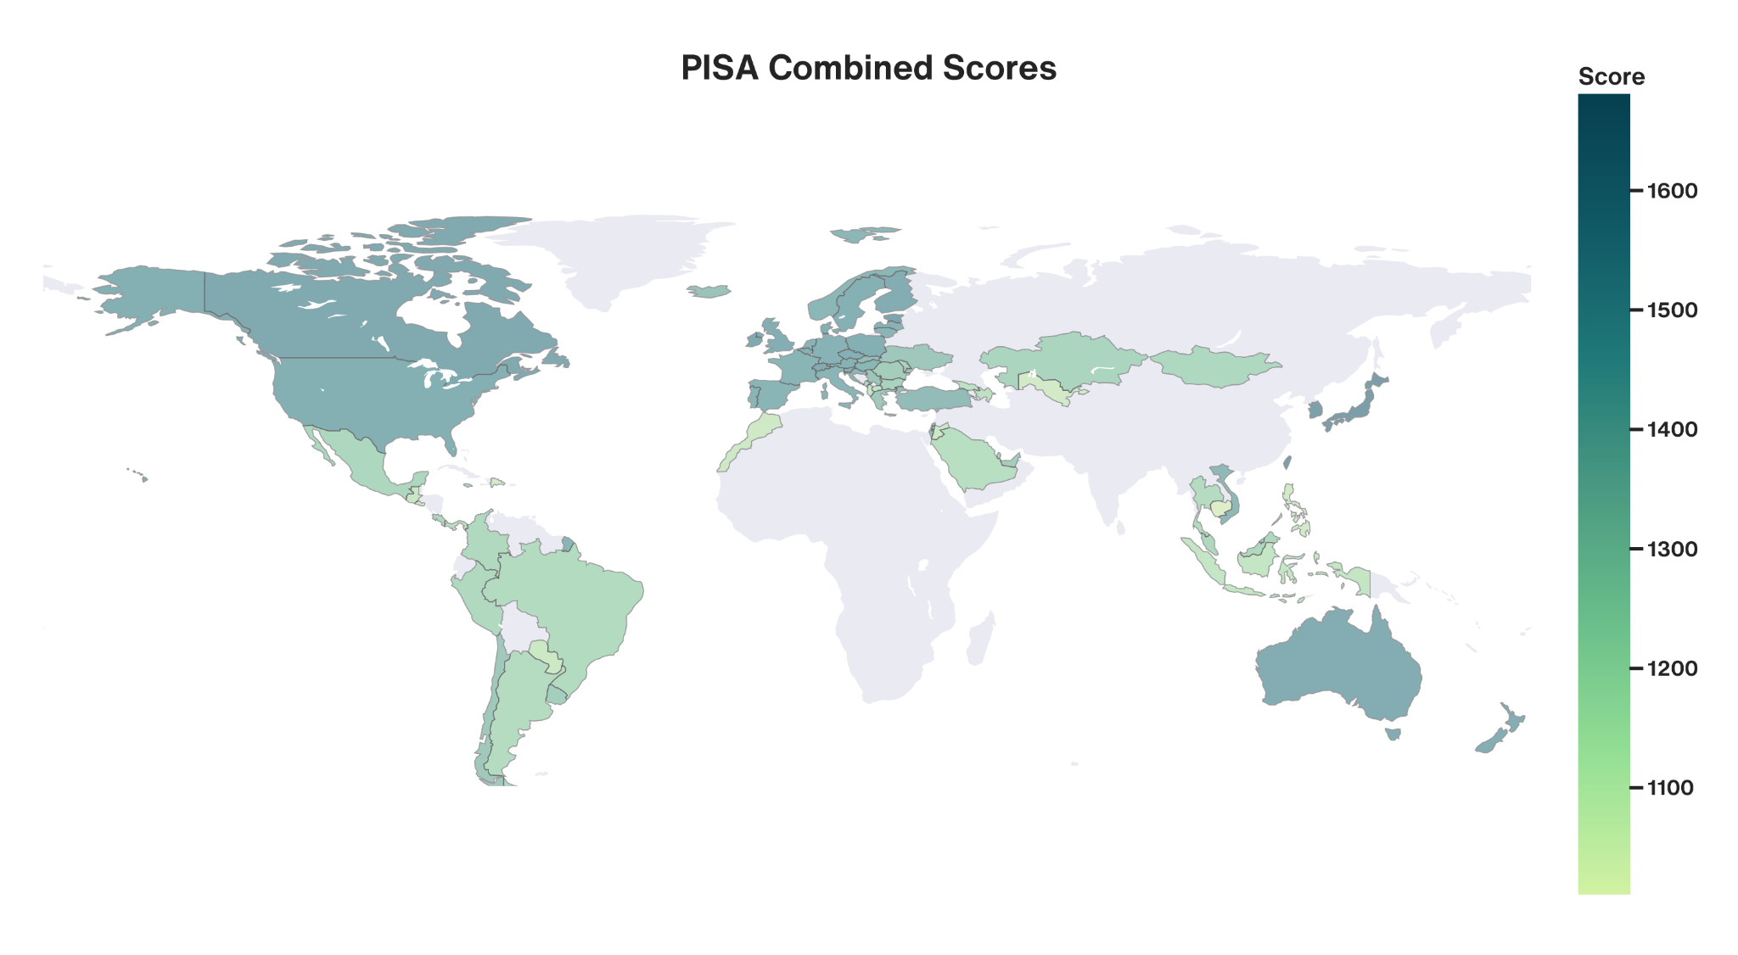

Slide 17
PISA Distribution Inequality Index (PDII) - Methodology Overview
Initial Data
Used mean and median scores for reading, math and science for each country and year
Ratio Construction
Calculated the ratio: [x]_ratio = [x]_mean / [x]_median for each subject (reading, math, science)
Combined the three subject ratios into a geometric mean to create a combined ratio, λ
Why Geometric Mean?: To penalize large deviations from central tendency
Ideal Scenario
In an ideal education system, the mean and median scores should be equal
Therefore, the ideal ratio for each subject and the combined ratio should be 1

Slide 18
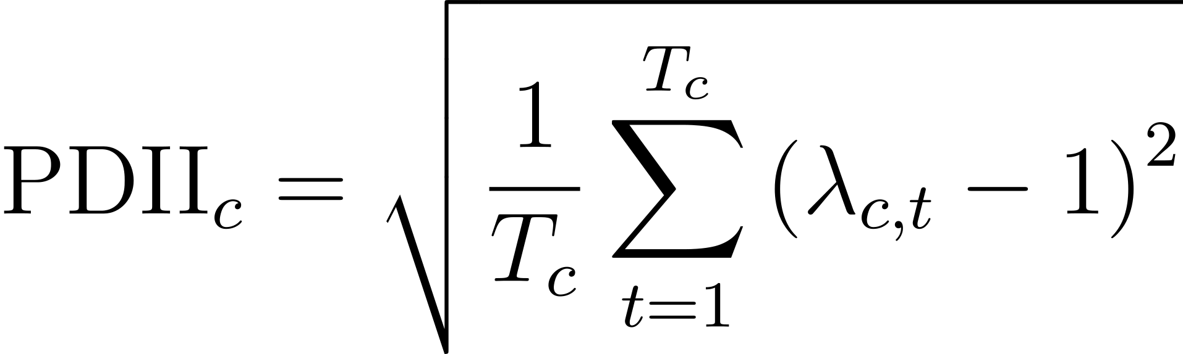
PISA Distribution Inequality Index (PDII) - Index Construction
Index Calculation
For each country (across all years), calculated the index as the squared deviation from the ideal ratio (1)
The index measures how far a country’s score distribution deviates from the ideal scenario
A higher PDII indicates greater deviation from the ideal scenario (ratio = 1), reflecting less homogeneity in student performance

Slide 19
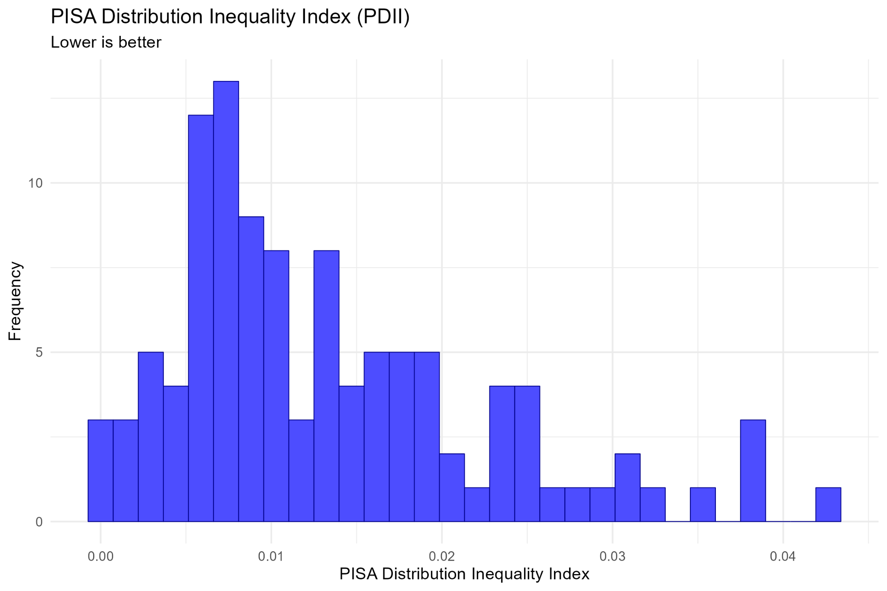

Slide 20
References…
Hillman, A. L., & Jenker, E. (2004). Economic Issues No. 33 - Educating Children in Poor Countries. International Monetary Fund.
Meyer, H. D., & Schiller, K. (2013). Gauging the Role of Non-educational Effects in Large-scale Assessments: Socio-economics, Culture and PISA Outcomes. PISA, Power, and Policy: The Emergence of Global Educational Governance.
Neuman, M. (2022). PISA data clusters reveal student and school inequality that affects results. PLoS ONE, 17(5 May). https://doi.org/10.1371/journal.pone.0267040
Sjøberg, S., & Jenkins, E. (2022). PISA: a political project and a research agenda. In Studies in Science Education (Vol. 58, Issue 1). https://doi.org/10.1080/03057267.2020.1824473

Slide 21
🙏🙏
DHANYAWAAD

